Slide 1
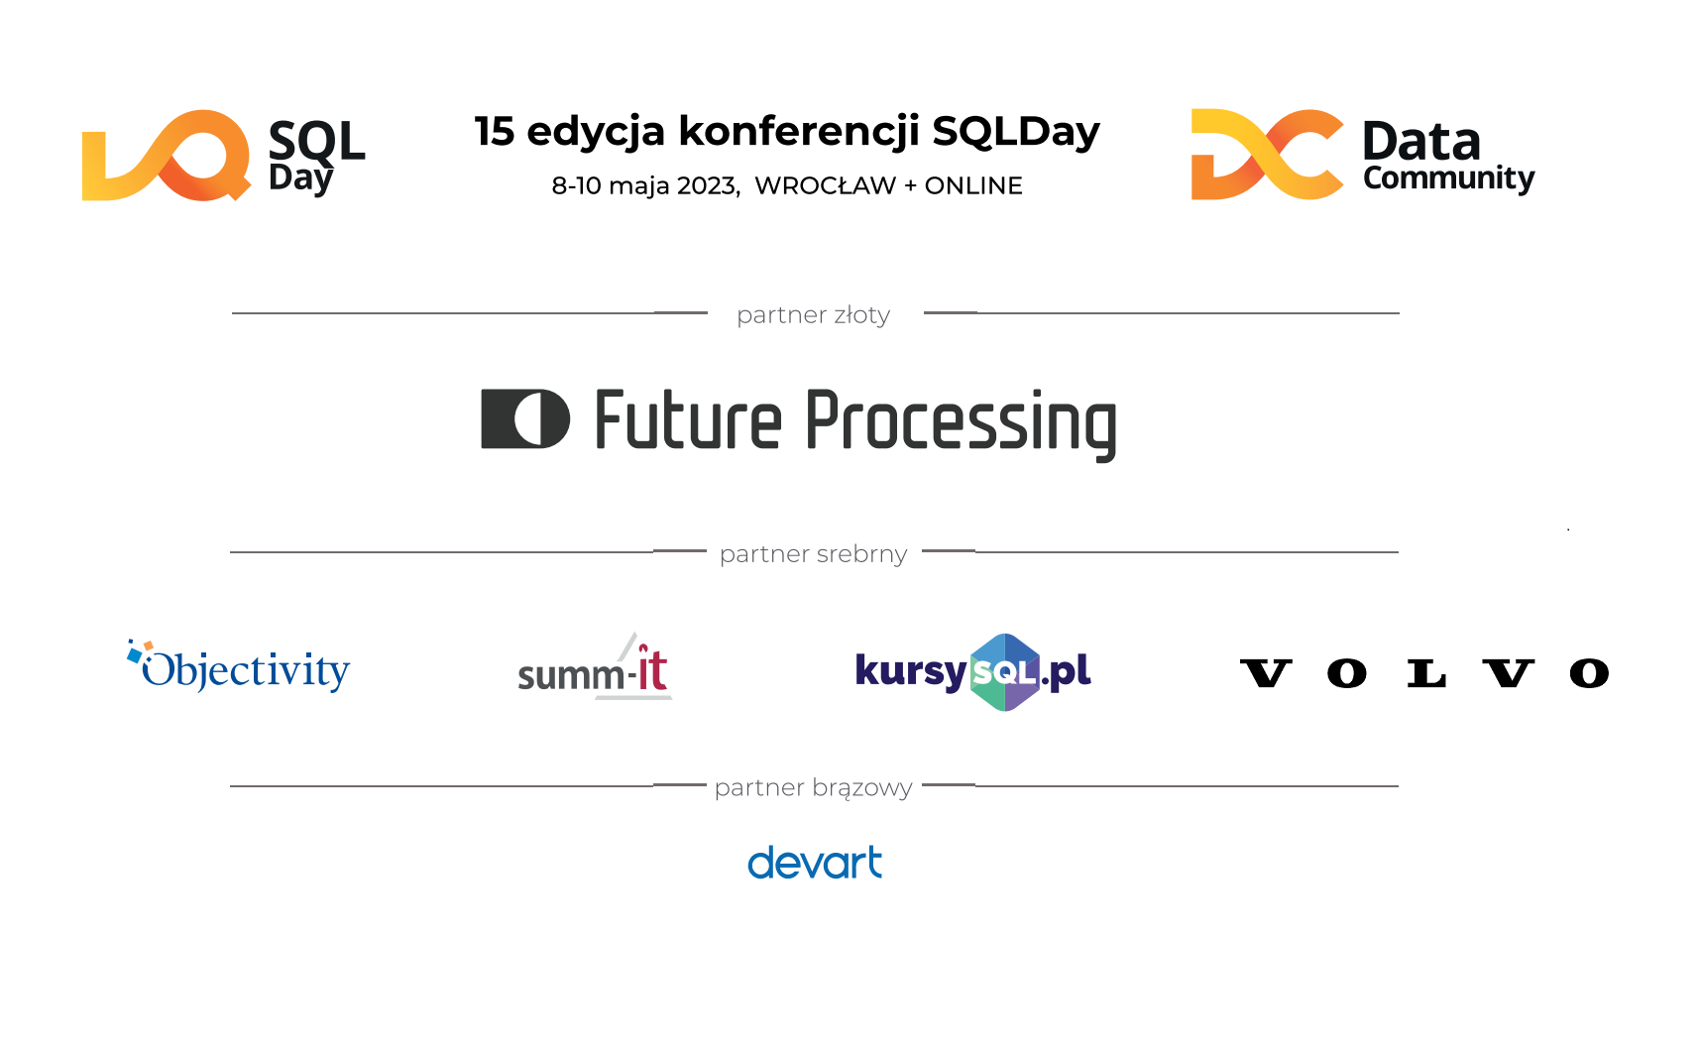

Slide 2
Szymon Lasota
SQL feat. Rest API call - nowe niesamowite możliwości

Slide 3







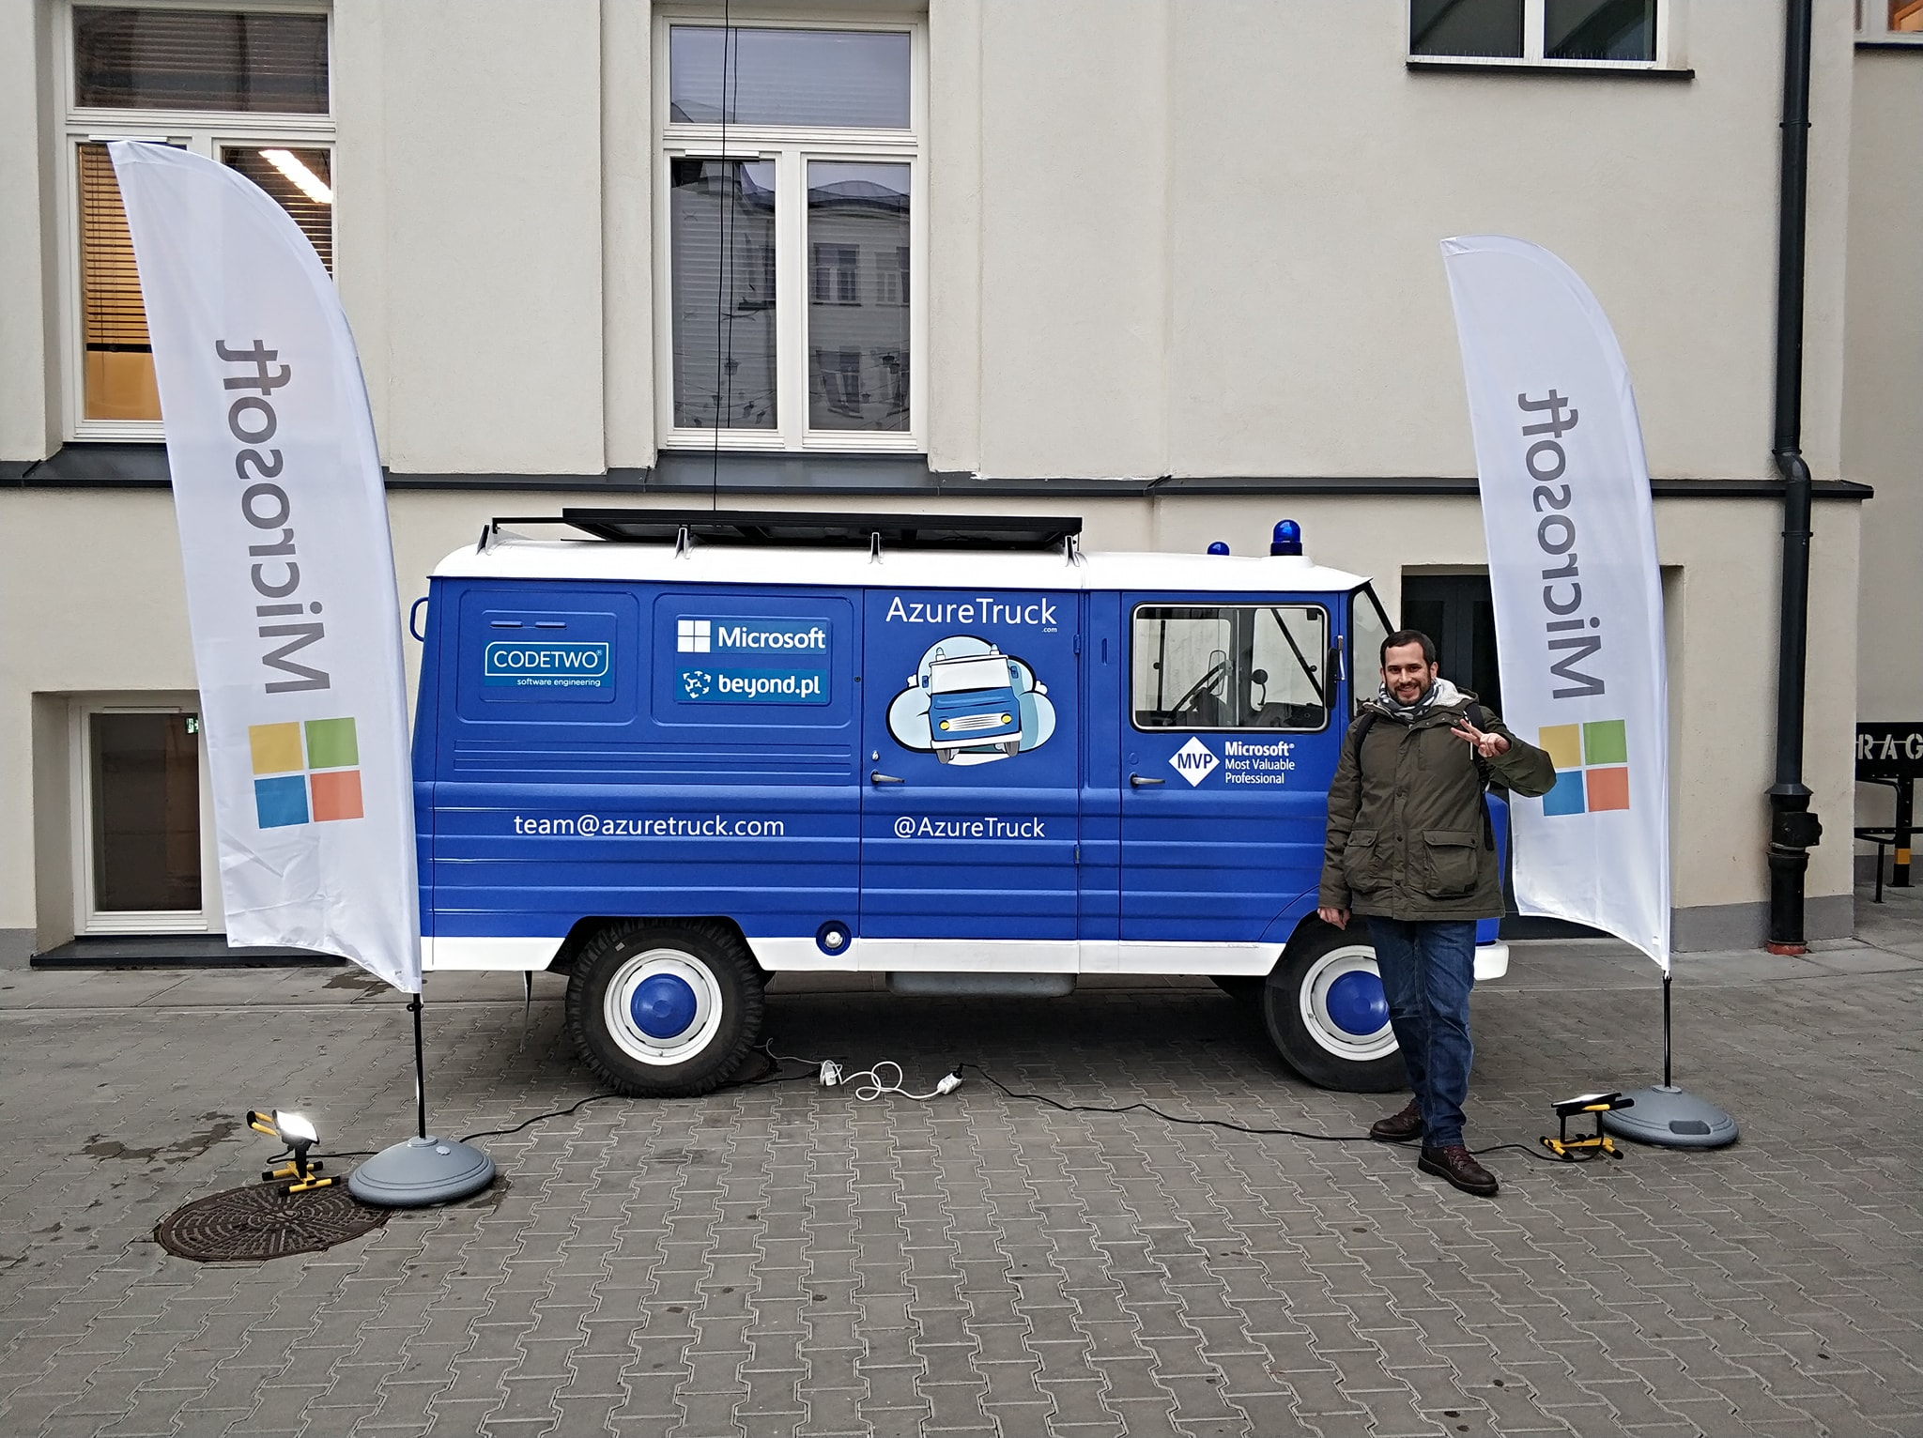










Szymon Lasota
Data & Cloud Domain Architect @ BEC Technologies
archalv@gmail.com
https://www.linkedin.com/in/szymon-lasota/
Since 2020

Slide 4
AGENDA
Azure SQL features
Azure SQL Database External REST Endpoints Integration
Azure only?/Azure Services
Request
Response
Permissions/Credentials
Limitations/Remarks
Demo
Data API builder for Azure SQL Databases (optional)

Slide 5
Azure SQL new features
https://learn.microsoft.com/en-us/azure/azure-sql/database/doc-changes-updates-release-notes-whats-new?view=azuresql
Azure SQL (Preview)
Azure SQL (GA)
Hyperscale
Serverless
RA-GZRS backups
LTR
Azure functions bindings (Python/JavaScript/Powershell/Java/C#)
SQL DB emulator
SQL Insights
128 vCore (from 80)
Ledger
Cross tenant CMK with TDE and automated key rotation
Named Replicas for Hyperscale
Active Geo-replication for Hyperscale
For Managed instance
CETAS (GA April 2023)
Managed Instance Link
Notes:
Co dwa tygodnie update
SQL Analytics forever in preview not SQL Insights

Slide 6
Azure SQL Database External REST Endpoints Integration
sp_invoke_external_rest_endpoint
Early Adopter Preview May 2022
Public Preview November 2022

Slide 7
Azure Services
Azure Service
Azure Functions | Azure Apps Service
Azure App Service Environment | Azure Static Web Apps
Azure Logic Apps | Azure Container Instances
Azure Event Grid | Azure Event Hubs
PowerApps / Dataverse | Azure Cognitive Services
Power BI | Microsoft Graph
Analysis Services | IoT Central
API Management

Slide 8
Azure Service | Domain
Azure Functions | *.azurewebsites.net
Azure Apps Service | *.azurewebsites.net
Azure App Service Environment | *.appserviceenvironment.net
Azure Static Web Apps | *.azurestaticapps.net
Azure Logic Apps | *.logic.azure.com
Azure Event Hubs | *.servicebus.windows.net
Azure Event Grid | *.eventgrid.azure.net
Azure Cognitive Services | *.cognitiveservices.azure.com
PowerApps / Dataverse | *.api.crm.dynamics.com
Microsoft Dynamics | *.dynamics.com
Azure Container Instances | *.azurecontainer.io
Azure Container Apps | *.azurecontainerapps.io
Power BI | api.powerbi.com
Microsoft Graph | graph.microsoft.com
Analysis Services | *.asazure.windows.net
IoT Central | *.azureiotcentral.com
API Management | *.azure-api.net
Notes:
If you want to invoke a REST service that is not within the allowed list, you can use API Management to securely expose the desired service and make it available to sp_invoke_external_rest_endpoint.
Outbound Firewall Rules control mechanism can be used to further restrict outbound access to external endpoints.

Slide 9
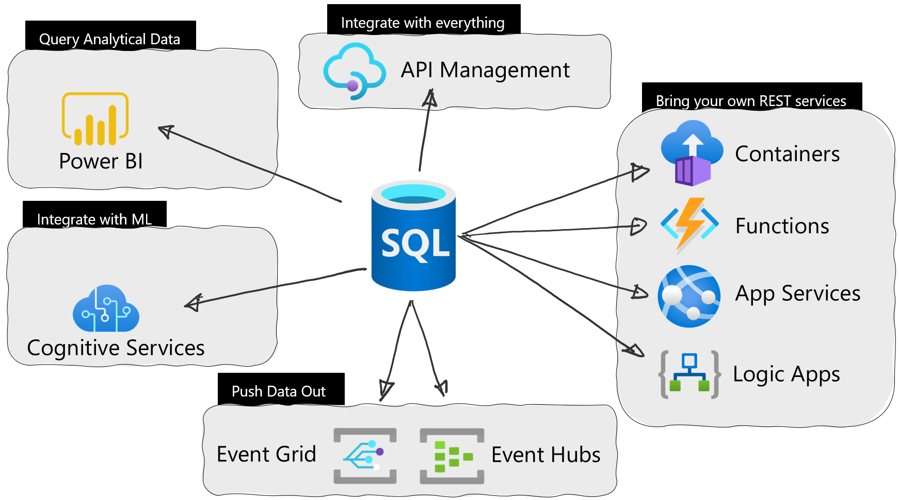
Azure only?
Notes:
integrate with Azure Event Hubs and Azure Event Grid is extremely easy now to push data out of Azure SQL to make it available to event-driven solutions.
integrate with Power BI so that you can execute a DAX query using the executeQueries REST endpoint and get the result right into Azure SQL DB
invoke any REST endpoint anywhere in the world, thanks to the integration with API Management
send a notification to a SignalR website right from Azure SQL DB thanks to already mentioned Azure Function integration
enrich your data using AI and ML models – for example to detect anomalies – via the integration with Azure Cognitive Services

Slide 10
Request & Response
@response contains a JSON document with the following schema:
EXEC @returnValue = sp_invoke_external_rest_endpoint
@url
[ , [ @payload = ] N'json_payload' ]
[ , [ @headers = ] N'http_headers_as_json_array' ]
[ , [ @method = ] 'GET' | 'POST' | 'PUT' | 'PATCH' | 'DELETE' ]
[ , [ @timeout = ] seconds ]
[ , [ @credential = ] credential ]
[ , @response OUTPUT ]
{
"response": {
"status": {
"http": {
"code": "",
"description": ""
}
},
"headers": {}
},
"result": {}
}
response: a JSON object that contains the HTTP result and other response metadata.
result: the JSON payload returned by the HTTP call. Omitted if the received HTTP result is a 204 (No Content).
Notes:
@url = N'url'
URL of the HTTPS REST endpoint to be called. url is nvarchar(4000) with no default.
[ @payload = N'json_payload' ]
Unicode string in a JSON format that contains the payload to send to the HTTPS REST endpoint. Payload must be a valid JSON document. payload is nvarchar(max) with no default.
[ @headers = N'headers' ]
Headers that must be sent as part of the request to the HTTPS REST endpoint. Headers must be specified using a flat JSON (a JSON document without nested structures) format. Headers defined in the Forbidden headers name list will be ignored even if explicitly passed in the headers parameter; their values will be discarded or replaced with system-supplied values when starting the HTTPS request.
The headers parameter is nvarchar(4000) with no default.
[ @method = N'method' ]
HTTP method for calling the URL. Must be one of the following values: GET, POST, PUT, PATCH, DELETE. method is nvarchar(6) with POST as default value.
[ @timeout = seconds ]
Time in seconds allowed for the HTTPS call to run. If the full HTTP request and response can't be sent and received within the defined timeout in seconds, the stored procedure execution will be halted, and an exception will be raised. Timeout starts when the HTTP connection starts and ends when the response, and payload included if any, has been received. timeout is a positive smallint with a default value 30. Accepted values: 1 to 230.
[ @credential = credential ]
Indicate which DATABASE SCOPED CREDENTIAL object will be used to inject authentication info in the HTTPS request. credential is a sysname with no default value.
[ @response = @variable OUTPUT ]
Allow the response received from the called endpoint to be passed into the specified variable. response is a nvarchar(max).

Slide 11
Response example
{
"response": {
"headers": {
"Content-Type": "application/json",
"Date": "Sun, 07 May 2023 10:23:08 GMT",
"Request-Context": "appId=cid-v1:78442c51-41a3-4243-8100-c09a1dac392e",
"Server": "Kestrel",
"Transfer-Encoding": "chunked"
},
"status": {
"http": {
"code": 200,
"description": "OK"
}
}
},
"result": {
"SQLDAY": "2023"
}
}
Return values
Execution will return 0 if the HTTPS call was done and the HTTP status code received is a 2xx status code (Success). If the HTTP status code received isn't in the 2xx range, the return value will be the HTTP status code received. If the HTTPS call can't be done at all, an exception will be thrown.

Slide 12
Permissions
Requires EXECUTE ANY EXTERNAL ENDPOINT database permission.
GRANT EXECUTE ANY EXTERNAL ENDPOINT TO [<PRINCIPAL>];
Grant permissions to use credential
Database users who access a DATABASE SCOPED CREDENTIAL must have permission to use that credential.
To use the credential, a database user must have REFERENCES permission on a specific credential:
GRANT REFERENCES ON CREDENTIAL::[<CREDENTIAL_NAME>] TO [<PRINCIPAL>];

Slide 13
Credentials
DATABASE SCOPED CREDENTIAL parameter IDENTITY for External REST Endpoints supports three options:
HTTPEndpointHeaders: send specified authentication data using the Request Headers
HTTPEndpointQueryString: send specified authentication data using the Query String
Managed Identity: send the System Assigned Managed Identity using the request headers (Both System-Assigned and User-Assigned Managed Identities are supported)
CREATE DATABASE SCOPED CREDENTIAL [https://<APP_NAME>.azurewebsites.net/api/<FUNCTION_NAME>] WITH IDENTITY = 'HTTPEndpointHeaders', SECRET = '{"x-functions-key":"<your-function-key-here>"}';
CREATE DATABASE SCOPED CREDENTIAL [https://<APP_NAME>.azurewebsites.net/api/<FUNCTION_NAME>] WITH IDENTITY = 'HTTPEndpointQueryString', SECRET = '{"code":"<your-function-key-here>"}';
CREATE DATABASE SCOPED CREDENTIAL [https://<APP_NAME>.azurewebsites.net/api/<FUNCTION_NAME>] WITH IDENTITY = 'Managed Identity', SECRET = '{"resourceid":"<APP_ID>"}';
Notes:
Credential name rules
The created DATABASE SCOPED CREDENTIAL must adhere to specific rules in order to be used with sp_invoke_external_rest_endpoint. The rules are the following:
Must be a valid URL
The URL domain must be one of those domains included in the allowlist
The URL must not contain a query string
Protocol + Fully Qualified Domain Name (FQDN) of the called URL must match Protocol + FQDN of the credential name
Each part of the called URL path must match completely with the respective part of URL path in the credential name
The credential must point to a path that is more generic than the request URL. For example, a credential created for path https://northwind.azurewebsite.net/customers can't be used for the URL https://northwind.azurewebsite.net
Some REST endpoints require authentication in order to be properly invoked. Authentication can usually be done by passing some specific key-value pairs in the query string or in the HTTP headers set with the request.
It's possible to use DATABASE SCOPED CREDENTIALS to securely store authentication data (like a Bearer token for example) to be used by sp_invoke_external_rest_endpoint to call a protected endpoint. When creating the DATABASE SCOPED CREDENTIAL, use the IDENTITY parameter to specify what authentication data will be passed to the invoked endpoint and how. IDENTITY supports three options:
HTTPEndpointHeaders: send specified authentication data using the Request Headers
HTTPEndpointQueryString: send specified authentication data using the Query String
Managed Identity: send the System Assigned Managed Identity using the request headers
Both System-Assigned and User-Assigned Managed Identities are supported:
If there is at least one User Managed Identity assigned, the defined Primary Identity will be used for authenticating when using a Managed Identity based Database Scoped Credential.
If there are no User Managed Identity assigned then the System Assigned Managed Identity will be used, if enabled, for authenticating when using a Managed Identity based Database Scoped Credential.
In case there are both User and System Managed Identitis defined,the User-Assigned Managed Identity will be used.
If there are more than one User Managed Identity assigned, only the Primary Identity will be used.
Collation and credential name rules
RFC 3986 Section 6.2.2.1 states that "When a URI uses components of the generic syntax, the component syntax equivalence rules always apply; namely, that the scheme and host are case-insensitive", and RFC 7230 Section 2.7.3 mentions that "all other are compared in a case-sensitive manner".
As there's a collation rule set at the database level, the following logic will be applied, to be coherent with the database collation rule and the RFC mentioned above. (The described rule could potentially be more restrictive than the RFC rules, for example if database is set to use a case-sensitive collation.):
Check if the URL and credential match using the RFC, which means:
Check the scheme and host using a case-insensitive collation (Latin1_General_100_CI_AS_KS_WS_SC)
Check all other segments of the URL are compared in a case-sensitive collation (Latin1_General_100_BIN2)
Check that the URL and credential match using the database collation rules (and without doing any URL encoding).

Slide 14
Limitations
Payload size
Payload, both when received and when sent, is UTF-8 encoded when sent over the wire. In that format, its size is limited to 100 MB.
URL length
The maximum URL length (generated after using the @url parameter and adding the specified credentials to the query string, if any) is 8 KB; the maximum query string length (query string + credential query string) is 4 KB.
HTTPS and TLS
Only endpoints that are configured to use HTTPS with at least TLS 1.2 encryption protocol are supported.
Headers size
The maximum request and response header size (all header fields: headers passed via @headers parameter + credential header + system supplied headers) is 8 KB.
Notes:
Wiec nie do procesowania danych

Slide 15
Throttling
The number of concurrent connections to external endpoints done via sp_invoke_external_rest_endpoint are capped to 10% of worker threads, with a maximum of 150 workers. On an single database throttling is enforced at the database level, while on an elastic pool throttling is enforced both at database and at pool level.
Msg 10928, Level 16, State 4, Procedure sys.sp_invoke_external_rest_endpoint_internal, Line 1 [Batch Start Line 0] Resource ID : 1. The outbound connections limit for the database is 20 and has been reached. See 'https://docs.microsoft.com/azure/azure-sql/database/resource-limits-logical-server' for assistance.
SELECT [database_name],
DATABASEPROPERTYEX(DB_NAME(), 'ServiceObjective') AS service_level_objective,
[slo_name] as service_level_objective_long,
[primary_group_max_outbound_connection_workers] AS max_database_outbound_connection,
[primary_pool_max_outbound_connection_workers] AS max_pool_outbound_connection
FROM sys.dm_user_db_resource_governance
WHERE database_id = DB_ID();

Slide 16
Remarks
Wait type
When sp_invoke_external_rest_endpoint is waiting for the call to the invoked service to complete, it will report an HTTP_EXTERNAL_CONNECTION wait type.
HTTP redirects
sp_invoke_external_rest_endpoint won't automatically follow any HTTP redirect received as a response from the invoked endpoint.
HTTP headers
sp_invoke_external_rest_endpoint will automatically inject the following headers in the HTTP request:
content-type: set to application/json; charset=utf-8
accept: set to application/json
user-agent: set <EDITION>/<PRODUCT VERSION> for example: SQL Azure/12.0.2000.8
If the same headers are also specified via the @headers parameter, the system-supplied values will take precedence and overwrite any user-specified values.
Notes:
If you are testing invocation of the REST endpoint with other tools, like cURL or any modern REST client like Postman or Insomnia, make sure to include the same headers that are automatically injected by sp_invoke_external_rest_endpoint to have the same behavior and results.

Slide 17
Batching data when possible
-- create the payload
DECLARE @payload AS NVARCHAR(MAX);
SET @payload = (
SELECT [object_id], [name], [column_id]
FROM sys.columns
FOR JSON AUTO );
-- invoke the REST endpoint
DECLARE @retcode INT,
@response AS NVARCHAR(MAX);
EXEC @retcode = sp_invoke_external_rest_endpoint @url = '<REST_endpoint>', @payload = @payload, @response = @response OUTPUT;
-- return the result
SELECT @retcode, @response;
Notes:
If you have to send a set of rows to a REST endpoint, for example to an Azure Function or to an event hub, it is recommended to batch the rows into a single JSON document, to avoid the HTTPS call overhead for each row sent. This can be done using the FOR JSON statement, for example:

Slide 18
DEMO
External REST Endpoint
Many samples from Microsoft at https://github.com/Azure-Samples/azure-sql-db-invoke-external-rest-endpoints

Slide 19
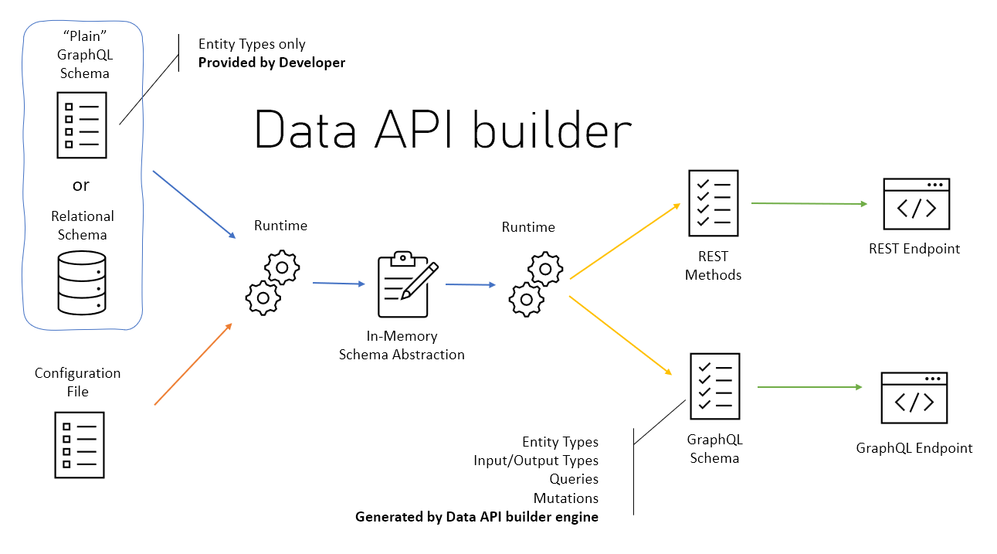
Data API builder for Azure SQL Databases
Notes:
Allow collections, tables, views and stored procedures to be accessed via REST and GraphQL
Support authentication via OAuth2/JWT
Support for EasyAuth when running in Azure
Role-based authorization using received claims
Item-level security via policy expressions
REST
CRUD operations via POST, GET, PUT, PATCH, DELETE
filtering, sorting and pagination
GraphQL
queries and mutations
filtering, sorting and pagination
relationship navigation
Easy development via dedicated CLI
Full integration with Static Web Apps via Database Connection feature when running in Azure
Open Source

Slide 20
Q&A

